Slide 1
Course on MBA- Sem III Supply Chain Management
Module 2: Supply Chain Integration
Dr. Ayush Gauta, (PhD- IIT Delhi, M.tech IIT roorkee, Btech Mechanical)

Slide 2
Contents
Manufacturing strategies, Demand Strategies
Push and Pull Strategies
What is Supply Chain Integration?
Framework for Supply Chain Network
Case Studies- Asian Paint
Case Studies- Dell Computer

Slide 3
Introduction to Supply Chain Integration
Effective SCM implies-
Efficient integration of suppliers, manufacturers, warehouses and stores.
Coordinate activities across the supply chain
Challenges can be met by integrating:
the front-end, customer demand
the back end, Production & manufacturing portion of the supply chain.
Various Supply Chain integration Strategies:
Push, Pull, Push-Pull Supply Strategy
Matching Products and industries with SC Strategies
Demand driven supply chain strategies

Slide 4
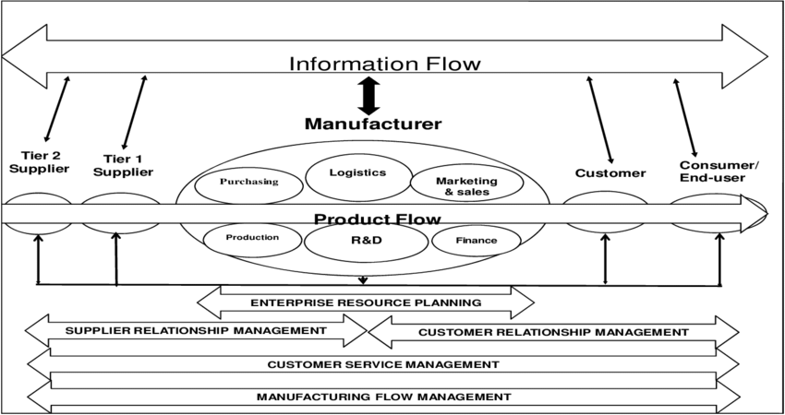

Slide 5
Supply Chain Integration
Coordinate activities across the supply chain, including coordinating production, transportation, inventory decisions and more generally, integrating the front-end of the supply chain – customer demand, to the back-end of the supply chain – the production and manufacturing portion.
Purpose
Reduce cost
Increase service level
Reduce the bullwhip effect
Better utilize resources
effectively respond to changes in the market place

Slide 6
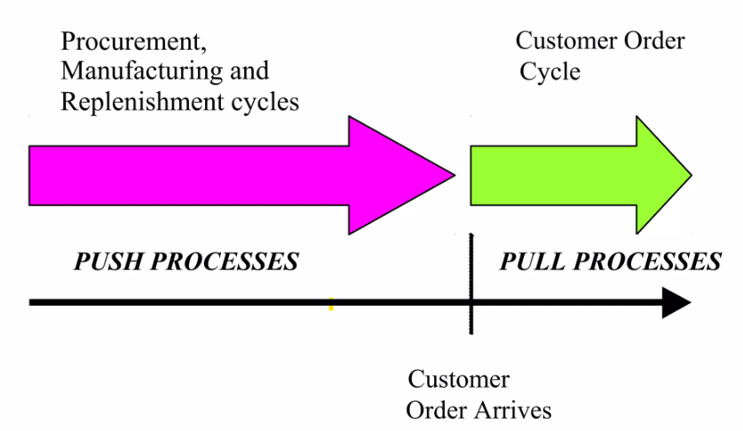
Supply Chain Integration
Coordinate activities across the supply chain, including coordinating production, transportation, inventory decisions and more generally, integrating the front-end of the supply chain – customer demand, to the back-end of the supply chain – the production and manufacturing portion.

Slide 7
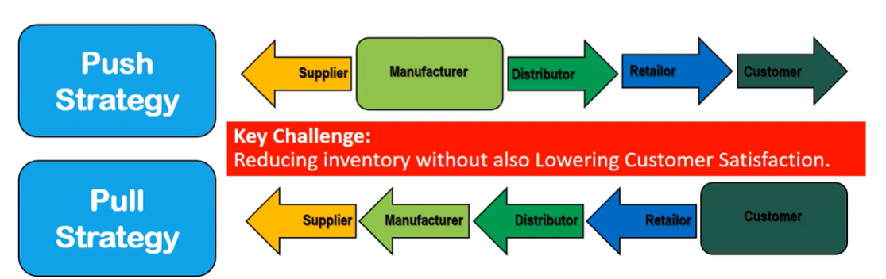
Push and Pull Strategy
A push/pull view of the supply chain categorizes processes based on whether they are initiated in response to a customer order (pull) or in anticipation of a customer order (push). This view is useful when considering strategic decisions relating to supply chain design.
Dynamic- Dell, Hyundai, BHEL

Slide 8
Push based Supply Chain
Push-based supply chain
Production and distribution decisions are based on long-term forecasts.
React slow and large variability lead to:
Inability to meet changing demand patterns
Excessive inventories
Larger and more variable production batches
Unacceptable service levels
Product obsolescence
Who is Keeping the Risk? Walmart vs Dell

Slide 9
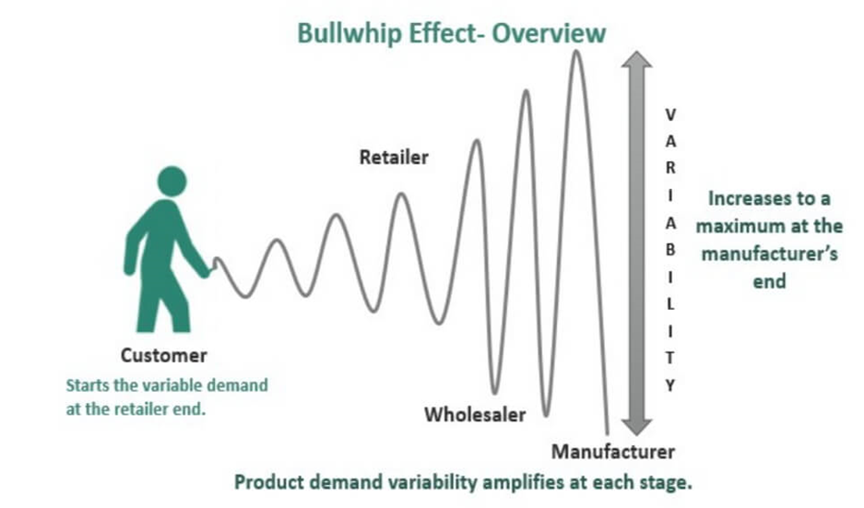
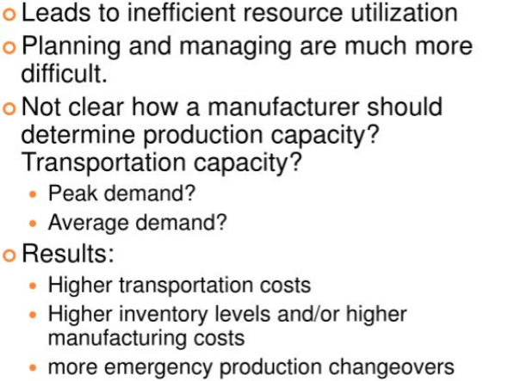
Bullwhip Effect in Push based Supply Chain

Slide 10
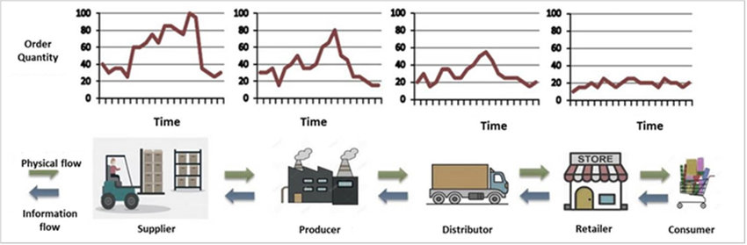
Bullwhip Effect in Push based Supply Chain

Slide 11
Pull based Supply Chain
Pull-based supply chain
Production and distribution are demand driven.
Effect:
Decrease lead times
Decrease inventory of retailers
Decrease variability in the system
Decrease inventory of manufacturer
Lead times too long, difficult to implement pull-based systems
Difficult to take advantage of economies of scale in manufacturing and transportation

Slide 12
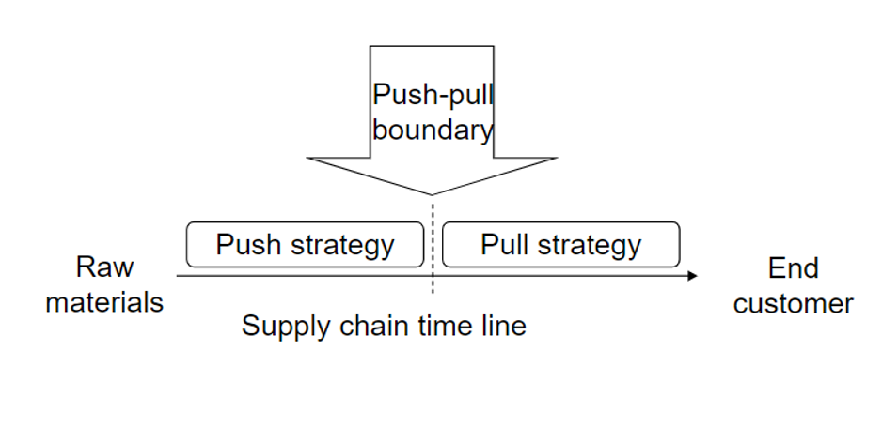
Push-Pull Supply Chain
Push-Pull supply chain
Some stages operated in a push-based manner; the remaining stages employ a pull-based strategy. (PC, delayed differentiation).
The interface Push Pull boundary

Slide 13
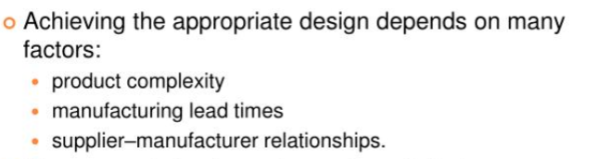
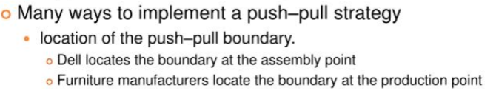
Push-Pull Supply Chain

Slide 14
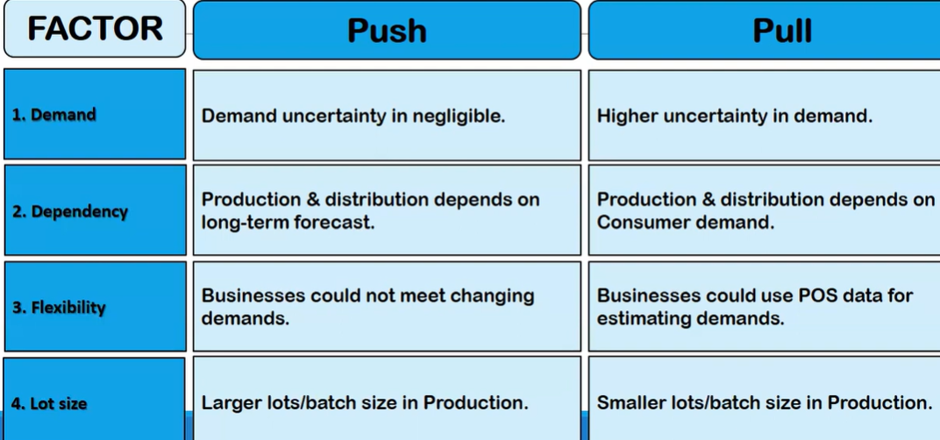
Comparison of Push-Pull Supply Chain

Slide 15
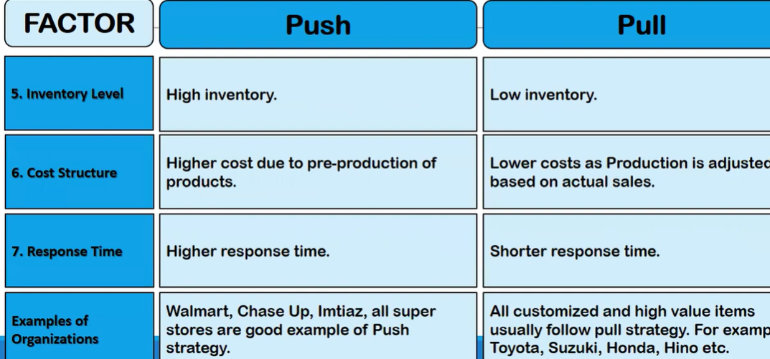
Comparison of Push-Pull Supply Chain

Slide 16
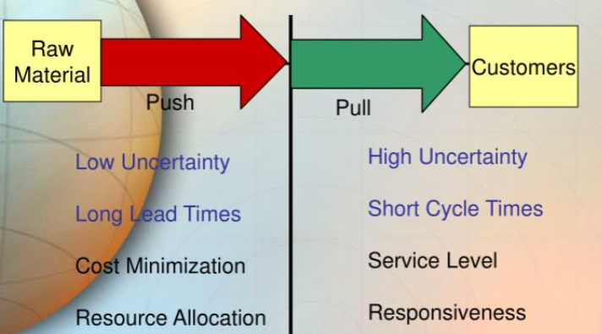
Comparison of Push-Pull Supply Chain
Push Portion
Low Uncertainty
Service level not an issue
Focus on cost minimization
Long Lead times
Complex supply chain structures
Supply Chain Planning portion are applied
Pull Portion
High Uncertainty
Focus on service level
Short Cycle time
Simple supply chain structures
Achieved by deploying flexible and responsive supply chain
Order fulfilment processes are applied

Slide 17
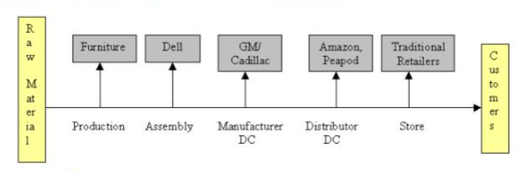
Locating Push Pull Boundaries

Slide 18
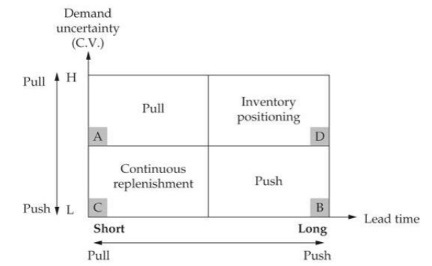
Matching Supply chain strategies with Products: Impact of lead time and demand uncertainty

Slide 19
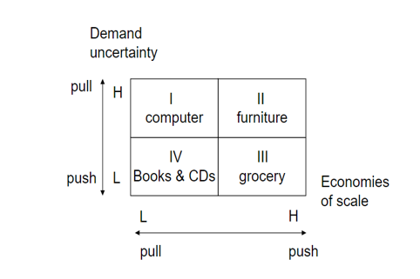
Identify the appropriate Supply Chain Strategy

Slide 20
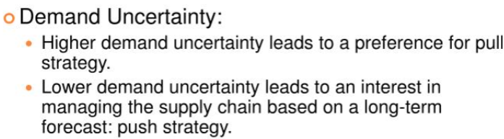
Identify the appropriate Supply Chain Strategy

Slide 21
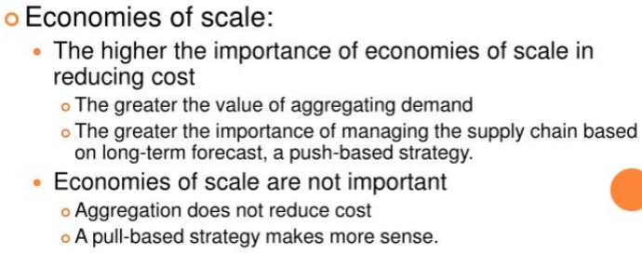
Identify the appropriate Supply Chain Strategy

Slide 22
Identify the appropriate Supply Chain Strategy
Box II
High demand uncertainty: pull
Important economies of scale: push
Furniture industry: production -pull; delivery-push
Box IV
Low demand uncertainty: push
Low economies of scale: pull
Books & CDs: push-pull strategy
Box- II
Automobile: push-based strategy
Failure of GM’s push-pull strategy

Slide 23
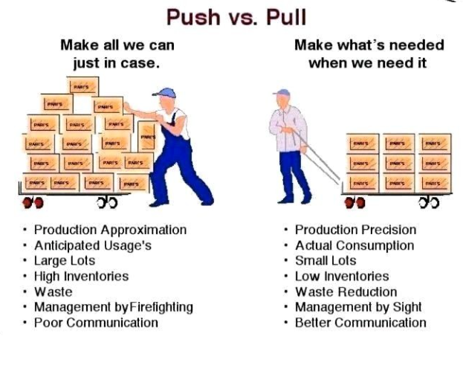
Push vs Pull Strategy

Slide 24
Competitive and Supply Chain Strategies
Competitive strategy defines the set of customer needs a firm seeks to satisfy through its products and services – To attain value for the customer
Product development strategy specifies the portfolio of new products that the company will try to develop
Marketing and sales strategy specifies how the market will be segmented and product positioned, priced, and promoted Walmart EDLP, McMaster-Car- responsiveness
Functional Strategy
Supply chain strategy determines procurement, transportation of materials, manufacturer of the of product or creation of service, distribution of product
All functional strategies must support one another and the competitive strategy- Now not in silos

Slide 25
The Value Chain- Linking supply chain and business strategy
Porter
begins with new product development (Creates specifications for the product)
Marketing and sales generate demand (Publisizing the customer priorities)
Using new product specifications, operations transforms inputs to outputs to create the product.
Distribution either takes the product to the customer or brings the customer to the product.
Service responds to customer requests during or after the sale.

Slide 26
The Value Chain- Linking supply chain and business strategy
Product Development Strategy
Portfolio of new product
Whether development will be made internally or outsourced
Marketing & Sales Strategy
How market will be segmented
How the product will be positioned/priced/promoted
Supply Chain Strategy
Procurement of raw materials
Transportation of materials to & from the company
Operations to provide service & distribution of the product
CISCO – outsourced component manufacturing and assembly
Toyota – production facility in its major markets
Each function in SC is crucial to satisfy customer needs
They can’t be formed in isolation
They are closely intertwined and must fit & support each other

Slide 27
Achieving Strategic Fit….
Strategic fit
– Competitive and supply chain strategies have aligned goals – defined by the capability of SC
_ Consistency between the customer priorities that the competitive strategy hopes to satisfy and the supply chain capabilities that the supply chain strategy aims to build
A company may fail because of a lack of strategic fit or because its processes and resources to execute the desired strategy do not provide by the capabilities.– Update with customer needs
Issue is- Customer priorities are evolving with time and advancement. – Japan, China…WRT market, status
Capability- Maruti even in a tier 3 city. – manifestation of SC strategy
EG- Market Intensive strategy- Zudio, Maruti, Patanjali, automobiles

Slide 28
Achieving Strategic Fit….
The competitive strategy and all functional strategies must fit together to form a coordinated overall strategy. Each functional strategy must support other functional strategies and help a firm reach its competitive strategy goal.
The different functions in a company must appropriately structure their processes and resources to be able to execute these strategies successfully.
The design of the overall supply chain and the role of each stage must be aligned to support the supply chain strategy.

Slide 29
How to Achieve Strategic Fit?
Understanding the customer and supply chain uncertainty
Understanding the supply chain capabilities
Achieving strategic fit

Slide 30
How to Achieve Strategic Fit?
Step 1: Understanding the Customer and Supply Chain Uncertainty
Quantity of product needed in each lot
Response time customers will tolerate
Variety of products needed
Service level required
Price of the product
Desired rate of innovation in the product

Slide 31
Impact of Customer Needs and Implied Demand Uncertainty?
Customer Need | Causes Implied Demand Uncertainty to …
Range of quantity required increases | Increase because a wider range of the quantity required implies greater variance in demand
Lead time decreases | Increase because there is less time in which to react to orders
Variety of products required increases | Increase because demand per product becomes less predictable
Number of channels through which product may be acquired increases | Increase because the total customer demand per channel becomes less predictable
Rate of innovation increases | Increase because new products tend to have more uncertain demand
Required service level increases | Increase because the firm now has to handle unusual surges in demand

Slide 32
Implied Uncertainty (Demand and Supply) Spectrum

Slide 33
Correlation Between Implied Uncertainty and Other Attributes
 | Low Implied Uncertainty | High Implied Uncertainty
Product margin | Low | High
Average forecast error | 10% | 40% to 100%
Average stockout rate | 1% to 2% | 10% to 40%
Average forced season-end markdown | 0% | 10% to 25%

Slide 34
Step 2: Understanding Supply Chain Capabilities
How to Achieve Strategic Fit?
How does the firm best meet demand?
Supply chain responsiveness is the ability to
Respond to wide ranges of quantities demanded
Meet short lead times
Handle a large variety of products
Build highly innovative products
Meet a high service level
Handle supply uncertainty

Slide 35
Supply Chain Capability….
1. | Facilities | (Manu, W/H, D,R)
 |  | Roles | Size | Location
 |  | More cost- Centralised- Effi | Higher EoS More cost- Centralised- Effi | City Centre- Respo Effi to respo
 |  | How many W/H or Retailors – Decide Respo. | How big W/H or Retailers – Decide Respo. | Country side: Effi (china)
2. | Inventory | Small vs Big Country
 |  | Ordering Cost- Effi | Carrying cost (eat profit) | High Service Level - respo
3. | Transportation | (Amazon, croma) | Lot size
 |  | Higher EoS at IB Logistics-Effi | Less EoS – OB -- Respo | FTL, LTL, Cross Docking
4. | Pricing | Supply Demand Mismatch | Toll, H hour | Respo to Effi
5. | Information |  | Coordination, mutual trust | Invade Effi. In respo - VMI
6. | Sourcing | Excellence in all fields | 3PL, 4PL, 5PL | Both Respo and Effi same time (IPost)
Capabilities should align with each other.

Slide 36
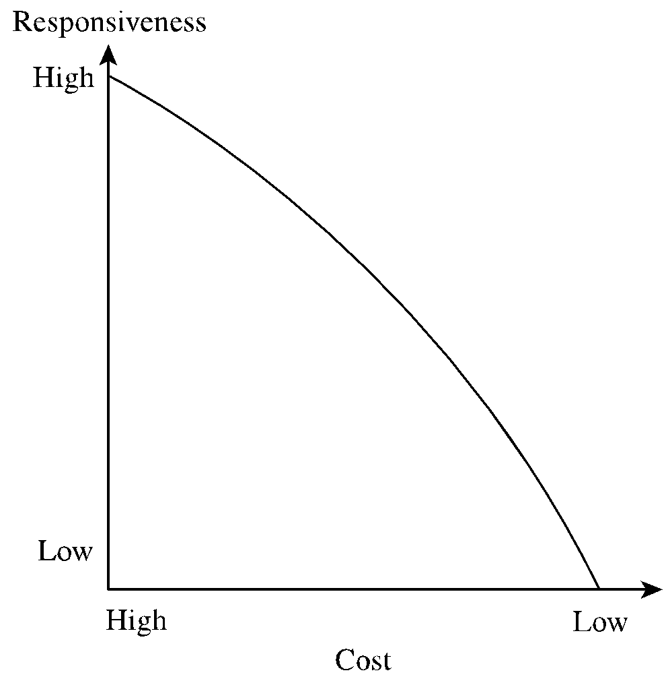
Cost-Responsiveness Efficient Frontier….

Slide 37
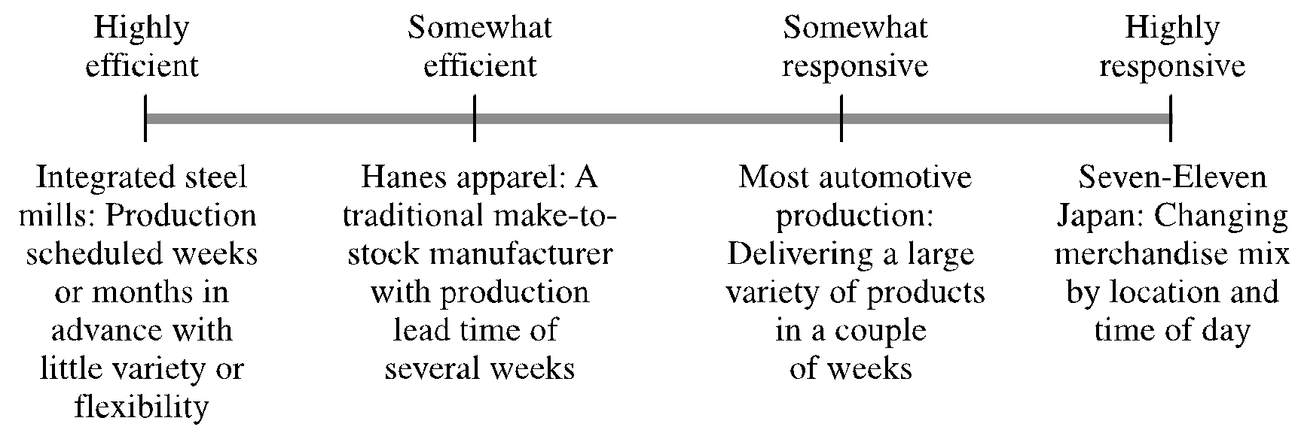
Responsiveness Spectrum….

Slide 38
Step 3: Achieving Strategic Fit….
Ensure that the degree of supply chain responsiveness is consistent with the implied uncertainty
Assign roles to different stages of the supply chain that ensure the appropriate level of responsiveness
Ensure that all functions maintain consistent strategies that support the competitive strategy

Slide 39
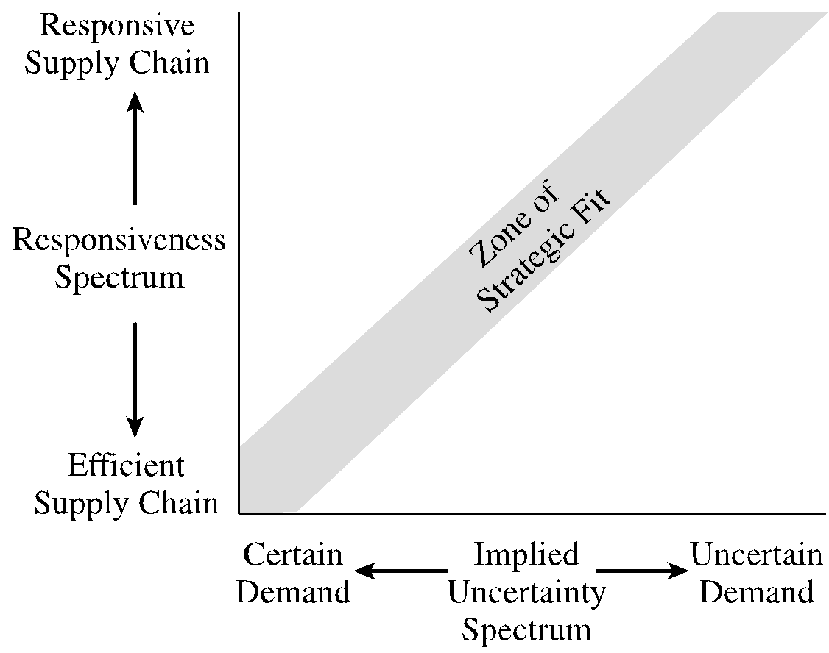
Zone of Strategic Fit….
Certain demand with response
WRT PLC Maruti

Slide 40
Efficient and Responsive Supply Chains….
 | Efficient Supply Chains | Responsive Supply Chains
Primary goal | Supply demand at the lowest cost | Respond quickly to demand
Product design strategy | Maximize performance at a minimum product cost | Create modularity to allow postponement of product differentiation
Pricing strategy | Lower margins because price is a prime customer driver | Higher margins because price is not a prime customer driver
Manufacturing strategy | Lower costs through high utilization | Maintain capacity flexibility to buffer against demand/supply uncertainty
Inventory strategy | Minimize inventory to lower cost | Maintain buffer inventory to deal with demand/supply uncertainty
Lead-time strategy | Reduce, but not at the expense of costs | Reduce aggressively, even if the costs are significant
Supplier strategy | Select based on cost and quality | Select based on speed, flexibility, reliability, and quality

Slide 41

Case Study 1 : Asian Paints Mastered The Management of Push-Pull Supply Chain

Slide 42



Introduction
Asian Paints Ltd. is an Indian multinational paint company, headquartered in Mumbai, Maharashtra, India. The company is engaged in the business of manufacturing, selling and distribution of paints, coatings, products related to home décor, bath fittings and providing of related services.
Asian Paints Limited is the largest paint company of India.
3rd largest in the Asia.
9th largest in the world.

Slide 43


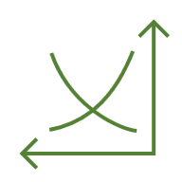
Background
Asian Paints started in 1942 as a partnership firm between 4 friends.
The ban on paints import during World War II provided an opportunity to Asian Paints to capture the market.
In the initial days, APL concentrated on its supply chain to cater to the needs of smaller and mid-cities of India as these cities were ignored by then leading players in paint businesses.

Slide 44





Production Units
The operational capacity of APL comes through 26 paint manufacturing plants spanning over 14 countries.
Role of Technology
Industry 4.0 are used at the plants for better management of its supply chain.
Data driven analytics help in predictive and prescriptive analytics.
Sensors on different machines churn out the data related to material used, manufacturing parameters, etc.
Analytics help in maintaining the entire distribution network.
Using Analytics framework help in optimizing cost and manufacturing performance.

Slide 45
Supply Chain of Asian Paints
Market forces driving the demand side
Growing customer aspirations
Average frequency of home painting has gone up
Initiatives by Govt. of India
Paint Industry’s lowered to slab of 18% GST
Demand from reality and construction sector
Supply Chain of APL offers a wide range of paints, both for decorative and for industrial segments.

Slide 46
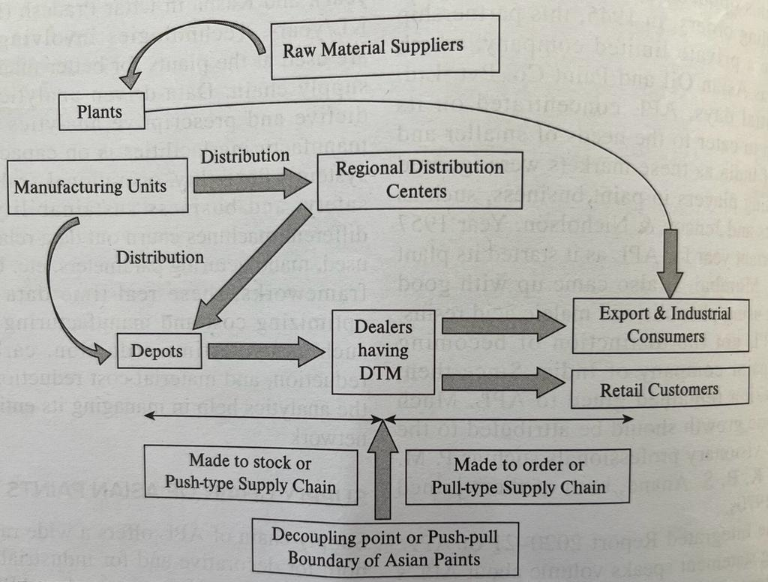
Asian Paints Supply Chain
The order fulfilment and replenishment cycle of APL aims to have the delivery the same day.
APL follows “direct to dealer” distribution network.
Thus shorter lead times enables to ensure a high service level, with very less inventory.

Slide 47

Demand scenario in paint industry
Paint demand is highly seasonal in India; driven by festivals such as Diwali etc.
Shelf life of majority of paints is shorter. It is a more perishable product than many other FMCG products.
There are large number of colours and shades in the catalogue of paint offering to consumers.
Paint Industry is also driven by local painters and contractors whose availability affects the demand.

Slide 48
Magic of Push – pull Supply chain of Asian Paints
Due to changing customer preference and unpredictability in demand, there was possibility of witnessing huge inventory and also stock-out of different SKUs.
From supply chain point of view, both inventory and stock-out are financial losses
To manage this, Asain Paints now uses Dealer Tinting Machine(DTM), which is a coloring machine available with dealer. This implemented the Postponement strategy. From the factory, only the base colors reach the dealers, when a customer places an order, the requisite quantity of color and colourants is mixed by computerised system in the DTM. Over 5000 different shades are produced by using one base color.

Slide 49
Advantages:
Stock-out are rare as the base paint can be converted to 5000 SKUs. Thus, supply chain in the downstream became demand-driven or Pull type supply chain converting to make-to-order supply chain or just-in-time or lean supply chain.
The upstream of the push-pull boundary, where DTM is located is forecast driven. The forecast is for the generic base paint i.e. the aggregated demand which is always more accurate than disaggregated demand, thus the upstream forecast is quite accurate.
Risk Poolling
No stock-out and sufficient Inventory
More Accurate forecast
Cost saving

Slide 50
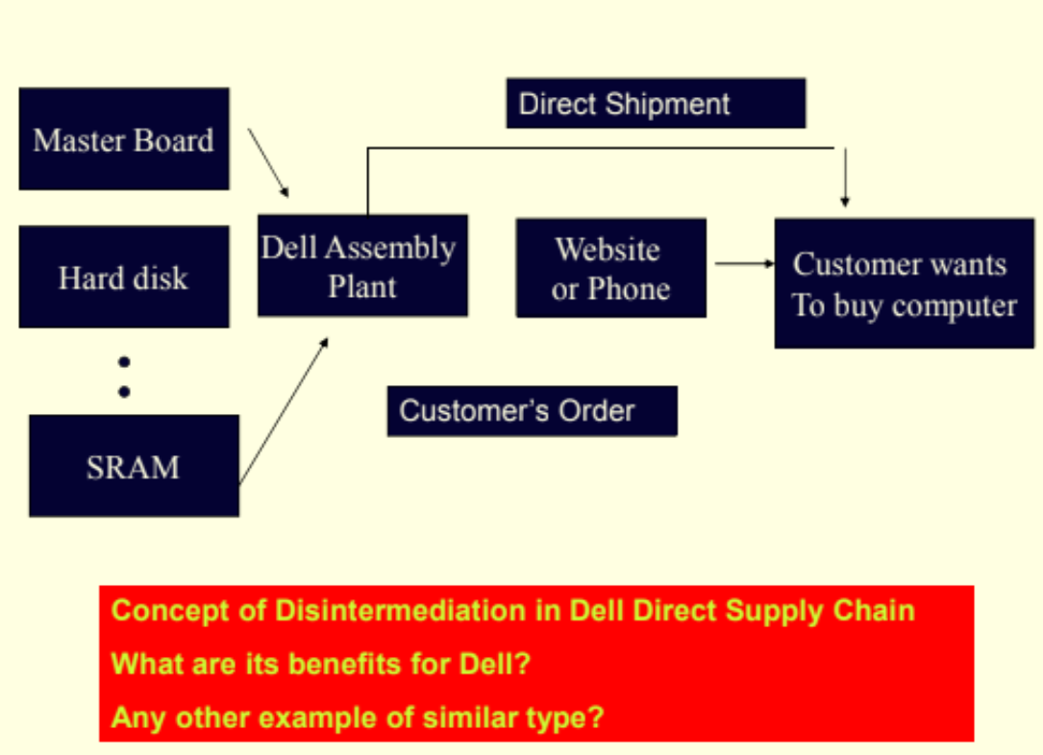
Case Study 2: Dell Supply Chain

Slide 51
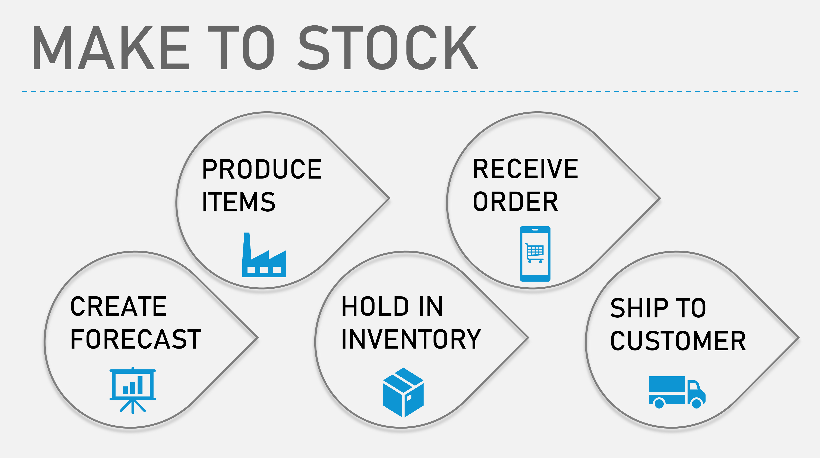
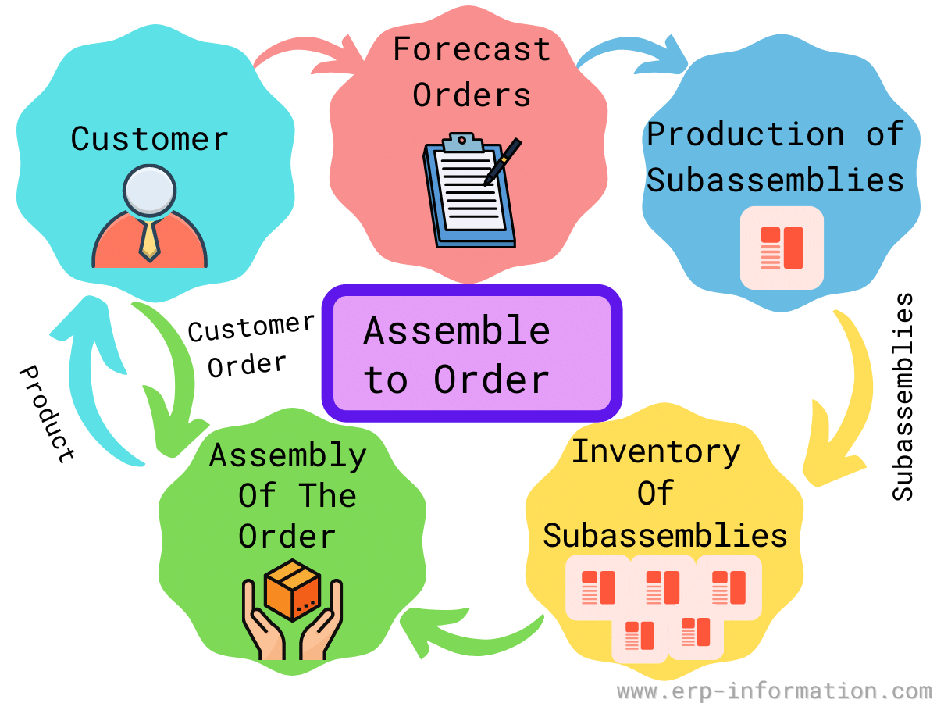
Manufacturing Strategies
Manufacturing Strategies
Make to Stock (MTS) –
Match production with consumer demand forecasts.
Demand should be accurately forecasted.
Inaccurate forecasts will lead to losses stemming from excessive inventory or stock outs
Assemble to Order (ATO) –
Products ordered by customers is produced quickly and is customizable to a certain extent.
Requires that the basic parts for the product are already manufactured but not yet assembled.
Benefits- getting products into customers' hands quickly while allowing for the product to be customizable

Slide 52
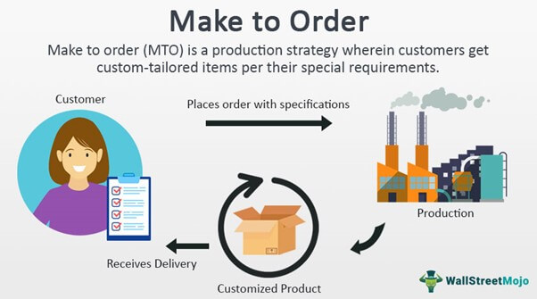

Manufacturing Strategies
Manufacturing Strategies
Make to Order (MTO) –
Allows consumers to purchase products that are customized to their specifications.
Only manufactures the end product once the customer places the order.
Additional wait time for the consumer to receive the product, but more flexible customization
Engineer to Order (ETO) -
Where customer specifications require unique engineering design, significant customization, or new purchased material.
Usually the customer is highly involved in the product design.
Each customer order results in a unique set of part numbers, bill of material, and routings. Custom design, slowest

Slide 53
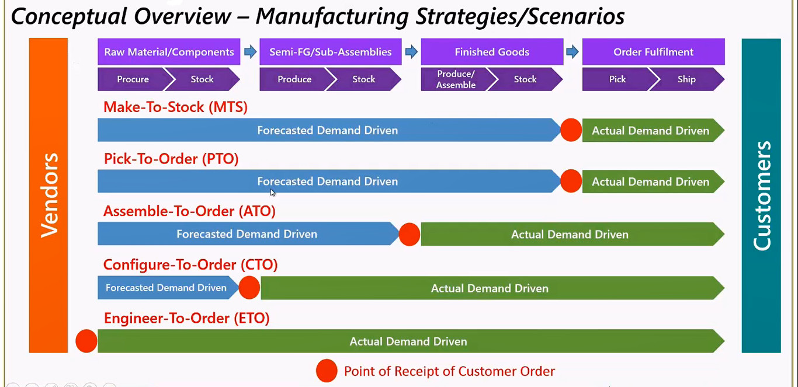

Slide 54
Manufacturing Strategies
Postponement Strategies (Delayed Product Differentiation)
Postponed Customization: Standard product produced; customization delayed until later in the supply chain.
Inventory Efficiency: Reduces need for multiple variations, lowering inventory costs.
Forecast Accuracy: Easier to predict demand for base products than for each variant.
Reduced Obsolescence: Minimizes unsold or obsolete products by aligning customization with real demand.
Flexibility: Faster response to market trends and customer preferences.

Slide 55
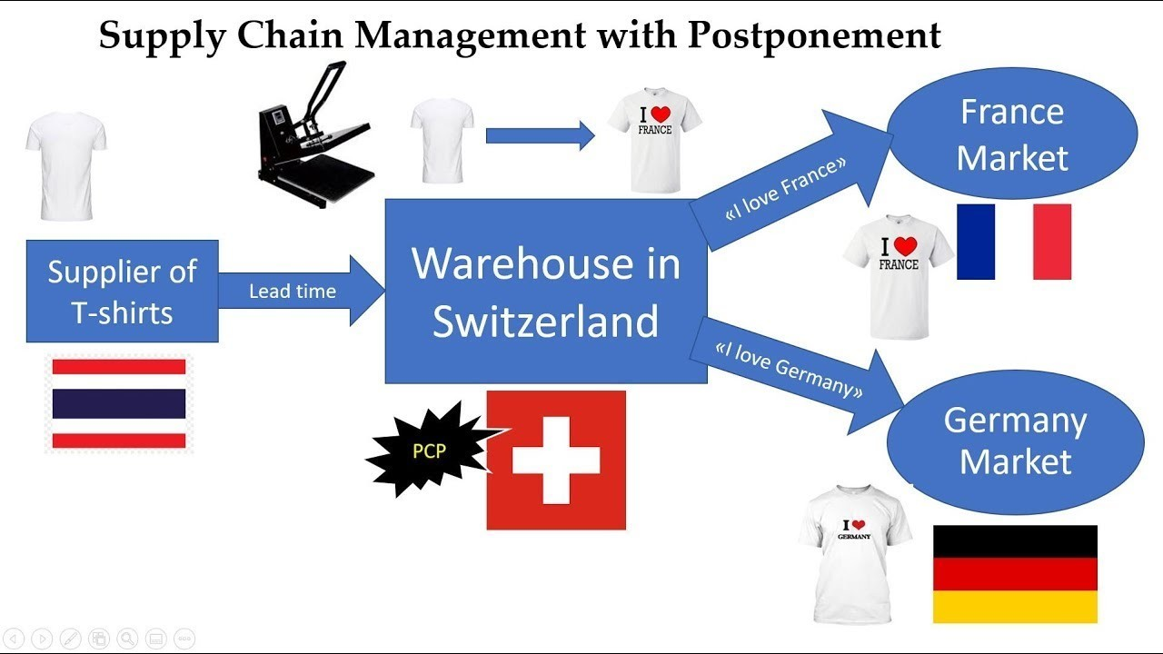
Example
Postponement Strategies (Delayed Product Differentiation)

Slide 56
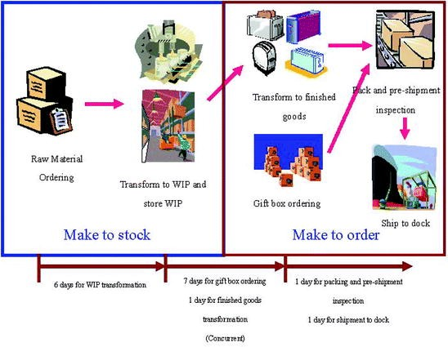
Example
Postponement Strategies (Delayed Product Differentiation)

Slide 57
Why to use Demand Driven Strategy?
Inaccuracy of the forecast has a detrimental impact on supply chain performance:
Lost Sales
Obsolete inventory
Inefficient resource utilization

Slide 58
Demand Driven Strategy
Demand Forecast: Using historical data to develop long-term estimates of expected demand.
Demand Shaping: Determining the impact of various marketing plans such as promotions, pricing discounts, rebates, new product introductions and product withdrawal on demand forecasts.

Slide 59
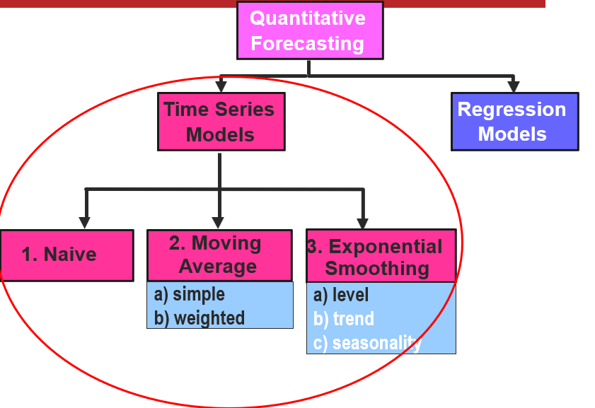
Demand Forecast: Using historical data to develop long-term estimates of expected demand.
Demand Forecast Method

Slide 60

Time Series Models
Try to predict the future based on past data
Assume that factors influencing the past will continue to influence the future
Notes:
14

Slide 61
Time Series Models: Components
Random
Trend
Seasonal
Composite

Slide 62
Product Demand over Time
Demand for product or service
Year
1
Year
2
Year
3
Year
4
Notes:
This slide illustrates a typical demand curve. You might ask students why it is important to know more than simply the actual demand over time. Why, for example, would one wish to be able to break out a “seasonality” factor?

Slide 63
Product Demand over Time
Trend component
Seasonal peaks
Demand for product or service
Actual demand line
Random variation
Year
1
Year
2
Year
3
Year
4
Now let’s look at some time series approaches to forecasting…
Borrowed from Heizer/Render - Principles of Operations Management, 5e, and Operations Management, 7e
Notes:
This slide illustrates a typical demand curve. You might ask students why it is important to know more than simply the actual demand over time. Why, for example, would one wish to be able to break out a “seasonality” factor?

Slide 64
Simple Moving Average
Assumes an average is a good estimator of future behavior
Used if little or no trend
Used for smoothing
F_{t+1} = Forecast for the upcoming period, t+1
n = Number of periods to be averaged
A _{t} = Actual occurrence in period t
Notes:
15

Slide 65

2a. Simple Moving Average
You’re manager in Amazon’s electronics department. You want to forecast ipod sales for months 4-6 using a 3-period moving average.
Sales
(000)
Month
1
4
2
6
3
5
4
?
5
?
6
?

Slide 66
Simple Moving Average
You’re manager in Amazon’s electronics department. You want to forecast ipod sales for months 4-6 using a 3-period moving average.
Sales
(000)
Moving Average
Month
(n=3)
1
4
NA
2
6
NA
3
5
NA
4
?
(4+6+5)/3=5
5
?
6
?

Slide 67
What if ipod sales were actually 3 in month 4
Simple Moving Average
Sales
(000)
Moving Average
Month
(n=3)
1
4
NA
2
6
NA
3
5
NA
4
?
5
3
5
?
6
?

Slide 68
Forecast for Month 5?
2 Simple Moving Average
Sales
(000)
Moving Average
Month
(n=3)
1
4
NA
2
6
NA
3
5
NA
4
3
5
5
?
(6+5+3)/3=4.667
6
?

Slide 69
Actual Demand for Month 5 = 7
Simple Moving Average
Sales
(000)
Moving Average
Month
(n=3)
1
4
NA
2
6
NA
3
5
NA
4
3
5
5
?
4.667
7
6
?

Slide 70
Forecast for Month 6?
Simple Moving Average
Sales
(000)
Moving Average
Month
(n=3)
1
4
NA
2
6
NA
3
5
NA
4
3
5
5
7
4.667
6
?
(5+3+7)/3=5

Slide 71
Weighted Moving Average
Gives more emphasis to recent data
Weights
decrease for older data
sum to 1.0
Simple moving
average models
weight all previous
periods equally
Notes:
This slide introduces the “weighted moving average” method. It is probably most important to discuss choice of the weights.

Slide 72
Weighted Moving Average: 3/6, 2/6, 1/6
Month
Sales
Weighted
Moving Average
(000)
1
4
NA
2
6
NA
3
5
NA
4
?
31/6 = 5.167
5
?
6
?

Slide 73
Weighted Moving Average: 3/6, 2/6, 1/6
Month
Sales
Weighted
Moving Average
(000)
1
4
NA
2
6
NA
3
5
NA
4
3
31/6 = 5.167
5
7
25/6 = 4.167
6
32/6 = 5.333

Slide 74
Exponential Smoothing
Assumes the most recent observations have the highest predictive value
gives more weight to recent time periods
F_{t+1} = F_{t} + α(A_{t} - F_{t})
e_{t}
Need initial
forecast F_{t}
to start.
F_{t+1} = Forecast value for time t+1
A_{t} = Actual value at time t
α = Smoothing constant
Notes:
24

Slide 75
Exponential Smoothing – Example 1
F_{t+1} = F_{t} + α(A_{t} - F_{t})
i
Ai
Fi
α =
F₂ = F₁+ α(A₁–F₁)
=820+.1(820–820)
=820
Notes:
26

Slide 76
Exponential Smoothing – Example 1
F_{t+1} = F_{t} + α(A_{t} - F_{t})
i
Ai
Fi
α =
This process continues
through week 10
Notes:
26

Slide 77
To Use a Forecasting Method
Collect historical data
Select a model
Moving average methods
Select n (number of periods)
For weighted moving average: select weights
Exponential smoothing
Select α
Selections should produce a good forecast
…but what is a good forecast?
Notes:
This slide introduces the exponential smoothing method of time series forecasting. The following slide contains the equations, and an example follows.

Slide 78
A Good Forecast
Has a small error
Error = Demand - Forecast
Notes:
This slide indicates one method of selecting α.

Slide 79
Measures of Forecast Error
e_{t}
MAD = Mean Absolute Deviation
MSE = Mean Squared Error
RMSE = Root Mean Squared Error
Ideal values =0 (i.e., no forecasting error)
Notes:
This slide illustrates the equations for two measures of forecast error. Students might be asked if there is an occasion when one method might be preferred over the other.

Slide 80

MAD Example
= 40
4
=10
What is the MAD value given the forecast values in the table below?
A_{t}
F_{t}
Month
Sales
Forecast
|A_{t} – F_{t}|
1
220
n/a
2
250
255
5
3
210
205
5
4
300
320
20
5
325
315
10
= 40
Notes:
31

Slide 81

MSE/RMSE Example
= 550
4
=137.5
What is the MSE value?
RMSE =
√137.5
=11.73
A_{t}
F_{t}
Month
Sales
Forecast
|A_{t} – F_{t}|
(A_{t} – F_{t})²
1
220
n/a
2
250
255
5
25
3
210
205
5
25
4
300
320
20
400
5
325
315
10
100
= 550
Notes:
31

Slide 82

Demand Shaping
Influencing the demand to match the planned supply using various tactics like price incentive, cost incentive, cost modification and product substitution.
The goal is to influence the consumers to choose specific products that the company has ready or in surplus or has planned to introduce.

Slide 83

Demand Shaping mostly used in case of -
New Product Launches
Price optimization
Sales promotions & Deals offered
Capacity Utilization

Slide 84
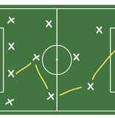
Tactics Used
Price Incentive
Cost Incentive
Cost Modification
Dynamic Pricing
Product Substitution

Slide 85




Demand Shaping
It is an operational supply chain management strategy
Methods such as price incentives, Discounts and product substitutions are used to entice customers to purchase their products
Demand shaping is carried out in order to bridge the gap between demand and supply

Slide 86
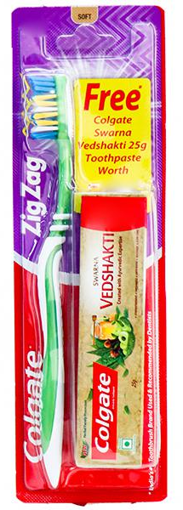

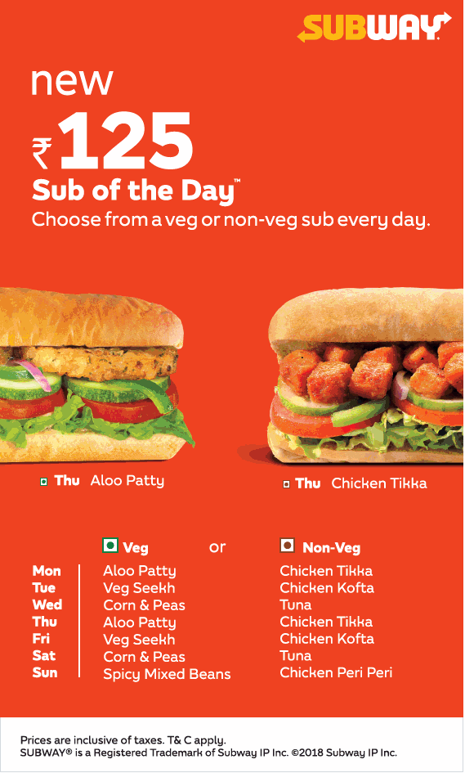
Examples of Demand Shaping
Dettol masks are given free with Dabur Chyawanprash to shape the demand of Dettol Masks
Colgate toothpaste is given free with their toothbrush to shape the demand of toothpaste.
Subway uses ‘Sub of the Day’ offer to shape its demand of different types of veg and non-veg subs.

Slide 87



Dynamic Pricing
Businesses set flexible prices for products or services based on current market demands
Commonly practiced in industries such as hospitality, tourism, entertainment , public transport.
Hotels industry alters its prices depending on the time of year, size of room.
Airlines and taxi services map real time demand to prices.
This Photo by Unknown Author is licensed under CC BY

Slide 88

Delivery Demand Shaping
Typically works well with online grocery shopping.
If few customers in an area have selected a particular time slot for grocery delivery and if a new order comes, grocery company will incentivize the new buyer to choose the same time of delivery.
This is the most effective way for the grocery company from an operation standpoint.
Delivery Window | Delivery fee
9:00 am – 11:00 am | Free
11:00 am – 1:00 pm | Rs 100
1:00 pm – 3:00 pm | Rs 50
3:00 pm – 5:00 pm | Rs 20
5:00 pm – 7:00 pm | Rs 30

Slide 89


Product Substitution Method
If demand patterns change and company doesn’t have enough stock of Product A, then the company attempts to steer the demand towards a substitute of product A.
Dell monitors real-time demand for its products, and if a certain laptop's stock falls below a certain threshold, it gives a discount on a similar laptop until the stock recovers.
Maruti offers discount on similar cars if demand for one model goes very high and production is expected to stay low due to reasons such as chip shortages .

Slide 90

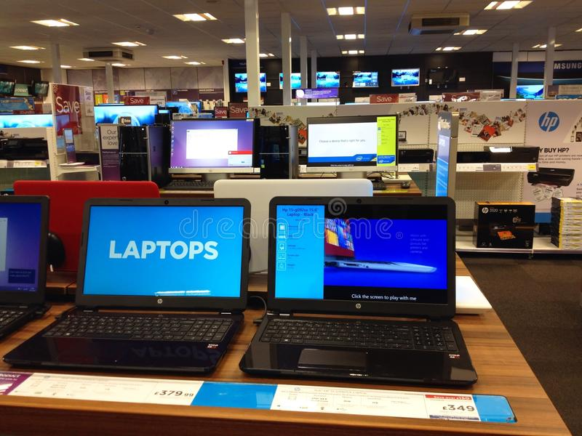
Examples in the industry
Stimulate demand of slow-moving product where there is inventory surplus by Markdown on price and additional discounts

Slide 91


Examples in the industry
Using price reductions to increase demand on certain sale events and using the sale rush to clear outstanding inventory

Slide 92


Examples in the industry
Cheaper rates for passengers booking earlier
Seat Reservations at higher price
Overbooking of seats in the airplane

Slide 93
Conclusion
Employing supply chain strategies to reduce the impact of forecast inaccuracy-
Select the Push-Pull boundary so that demand is aggregated over different dimensions: Product Geography and Time
Use market analysis, demographic and economic trends to improve forecast.
Incorporate collaborative planning and forecasting processes with customers to better understand market demand, impact of promotions, pricing and advertising.
Determine the optimal assortment of products by store to reduce the impat of competing SKUs in the same market

Slide 94
Thank You

